Slide 1
Distribution Service Model
Utilize DST Systems’ Rollover Distribution Service to facilitate distributions to existing IRAs. The Rollover Distribution Platform provides two pathways to enable this process.
1. Call Center
Service Rep fields a participant call, accesses the rollover distribution platform and assists the participant with initiating a rollover distribution to an existing IRA with an IRA provider.
2. Web (Self-Service)
Participant accesses the rollover distribution platform to initiate a rollover distribution to an existing IRA with an IRA provider on their own.

Slide 2
Voya Revenue and Cost Savings Opportunity
Voya would have the opportunity to monetize the rollovers that are going to DST’s marketplace IRA providers. Voya would also realize a cost savings to electronically process and fund rollovers to marketplace IRA providers.
Revenue Opportunity
# of rollovers X $25/per =
$XX/year
Cost Savings
Print and mailing estimate at $1/per-$150,000
Call Center time keying in rollover funding instructions
Elimination of reissuing lost checks

Slide 3
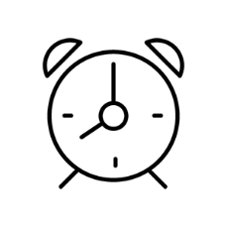
Distribution Service Model Benefits
Paperless Process
The rollover distribution platform eliminates paperwork by processing rollovers online with ACH check processing, reducing number of steps and potential for errors.
Transaction Expense Recapture
By facilitating rollovers to existing IRAs through the DST rollover distribution platform, recordkeepers partially recoup the cost of rollover processing through a per rollover transaction fee.
Less Time Out of Market
DST-processed rollovers take 2–4 days. Traditionally, rollovers can take an average of 38–45 days to process. Historical data suggests that time out of market, compounded over a full career and multiple job changes, can negatively impact retirement savings growth.

Slide 4
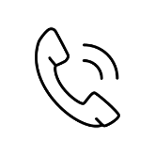
Distribution Service Model | Call Center
1
2
3
5
Participant
Call Center
Rollover Platform
Recordkeeper
Participant calls the Call Center
Call Center Rep accesses the platform
Call Center Rep (with participant):
Selects a provider from a marketplace of partner providers
Enters the account type and account number
Reviews ‘How your money will be transferred’
Processes distribution
Provides weekly file
4
ACH and/or check instructions returned to the Call Center

Slide 5
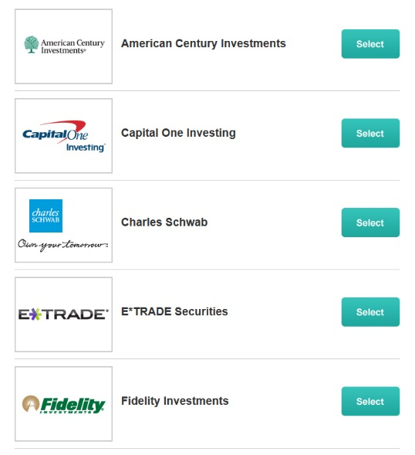
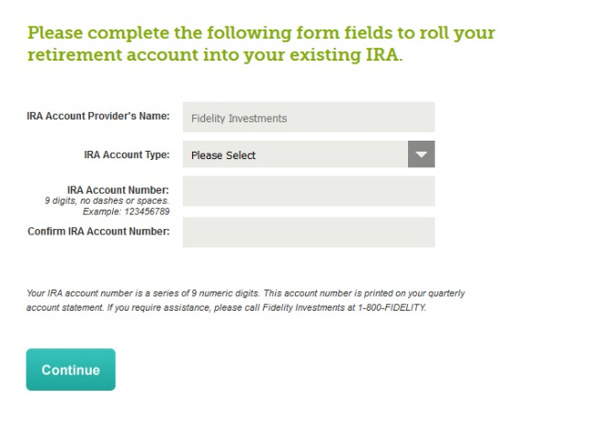
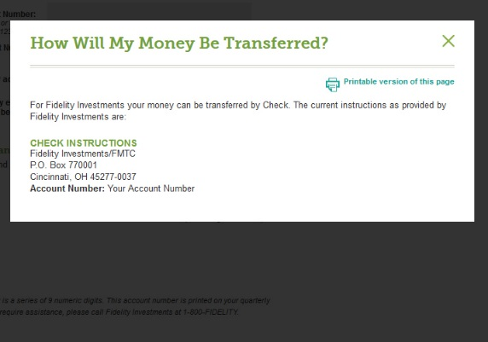
Distribution Service Model Screens
Rollover Platform
a
b
c

Slide 6
Distribution Service Model Requirements
High-Level Requirements
Authentication web service to connect the recordkeeper to the DST Distribution Platform
Funding Instructions web service for the recordkeeper to receive DST formatted funding instructions of the IRA provider
XML Distribution File from the recordkeeper containing detail of rollover distributions processed utilizing DST funding instructions
SFTP for delivery of distribution file containing data for DST processing and invoicing
Reporting to measure success criteria of program

Slide 7
Distribution Service Model Timeline
Implementation period: 3 months, minimum Chronology of tasks:
Sales / RM engages client in high-level discussions
Product team is brought in to discuss details with business / IT analysts
Statement of work for initiative; secure agreement to proceed
Initial BRD; intake process; secure estimates; review with client
Finalize BRD; estimates; sign off
Secure resources for development, testing, etc.
Define project components and timeline
Develop, Test (QA, UAT)
Sign off, implementation
Monitor and measure success criteria

